Slide 1

Project Title: Cloud Based E-Commerce Platform
Software Development & Construction
Instructors:
Dr. Zunnurain Hussain & Umair Makhdoom
Members:
Muhammad Zubair Akhter & Numan Tahir

Slide 2
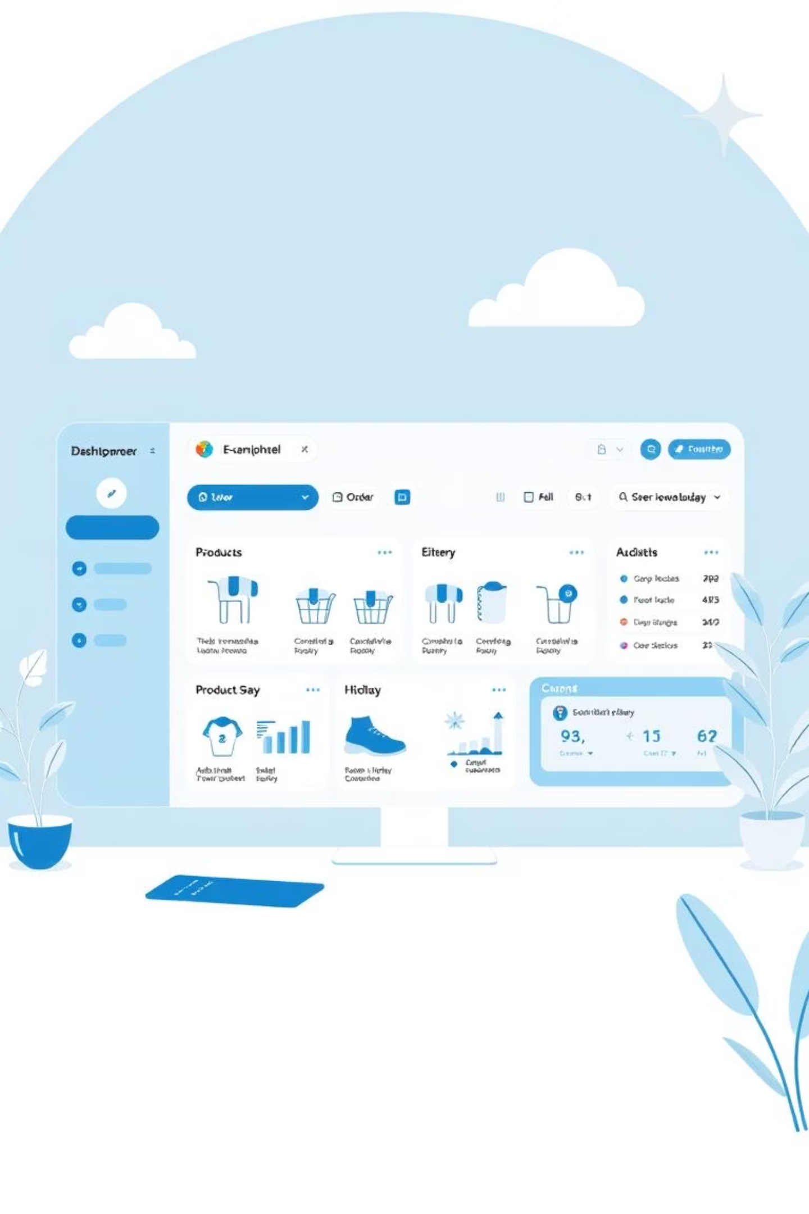
ShopSwift: Executive Summary
High-Performance & Scalable
Dual User Archetypes
Serves Customers (browse/purchase) and Administrators (manage inventory/ fulfillment).
ShopSwift is a modern e-commerce application designed for scalability and seamless user experiences.
Decoupled Architecture
Integrates with Commercetools and provides a blueprint for AWS Cloud deployment.

Slide 3

Technology Stack
React 19
Tailwind CSS
ESM-based Frontend Framework
Utility-first Styling
TypeScript
Commercetools
Type-safe Development
Headless Commerce Engine
AWS
Vite / esm.sh
Cloud Blueprint (ECS, Kinesis, S3, CloudFront)
Efficient Build Tools

Slide 4
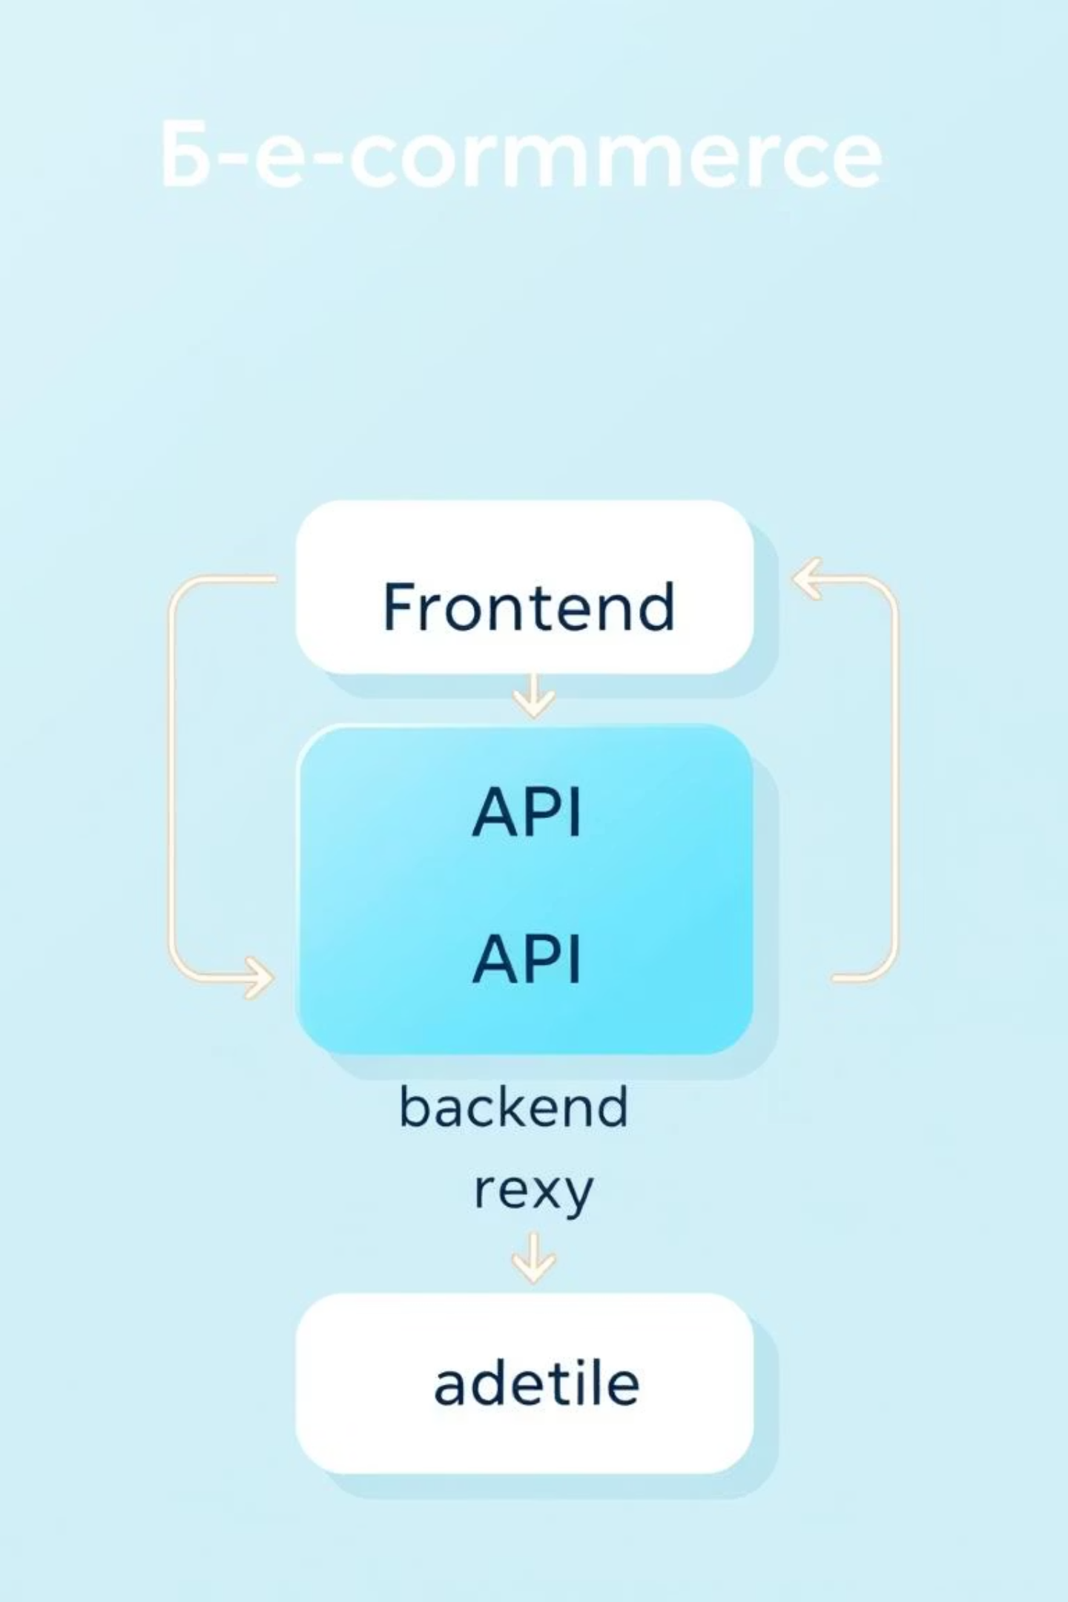



Project Architecture: Headless Approach
Frontend
Responsive SPA for state, user interactions, and client-side routing.
API Service Layer
Centralized hub for OAuth2 authentication and Commercetools requests.
Backend Proxy
Node.js ECS-ready service to secure sensitive API credentials and handle server-side logic.

Slide 5

Feature Set: Customer Experience
Dynamic Storefront
Real-time product discovery with high-quality imagery and descriptions.
Reactive Shopping Cart
Persistent cart management with automatic calculations.
Streamlined Checkout
Secure shipping information capture and order submission.
Live Notifications
Toast-based feedback system for all major interactions.

Slide 6

Feature Set: Administrative Management
1
Inventory Dashboard
Real-time view of product projections (staged and published).
2
Price Control
Dynamic price updating with immediate synchronization.
3
Order Fulfillment Center
Sophisticated interface to track order lifecycles.
4
Optimistic UI
Immediate interface updates for lag-free admin actions.

Slide 7

Technical Implementation Details
Authentication & Authorization
Data Management
Commercetools Integration: Product Projections for frontend, Products API for admin.
Robust role-based access control (RBAC) model.
Admins access inventory/order management; Customers manage profiles/history.
Event-Driven Analytics: Captures user journeys (VIEW_HOME, ADD_TO_CART, PURCHASE) for recommendations and sales reporting.
OAuth2 Client Credentials flow with token caching for minimal latency.

Slide 8

Security Model & AWS Infrastructure
Security Model
AWS Infrastructure Blueprint
Credential Management: Backend proxy (AWS ECS) hides Client Secrets.
Frontend Hosting: AWS S3 + Amazon CloudFront for global delivery.
Input Validation: Form data sanitized before transmission.
Compute: AWS Fargate (ECS) for the Node.js API proxy.
Secure Routing: Protected views (Admin) shielded by authentication.
Designed for a highly available cloud environment.

Slide 9
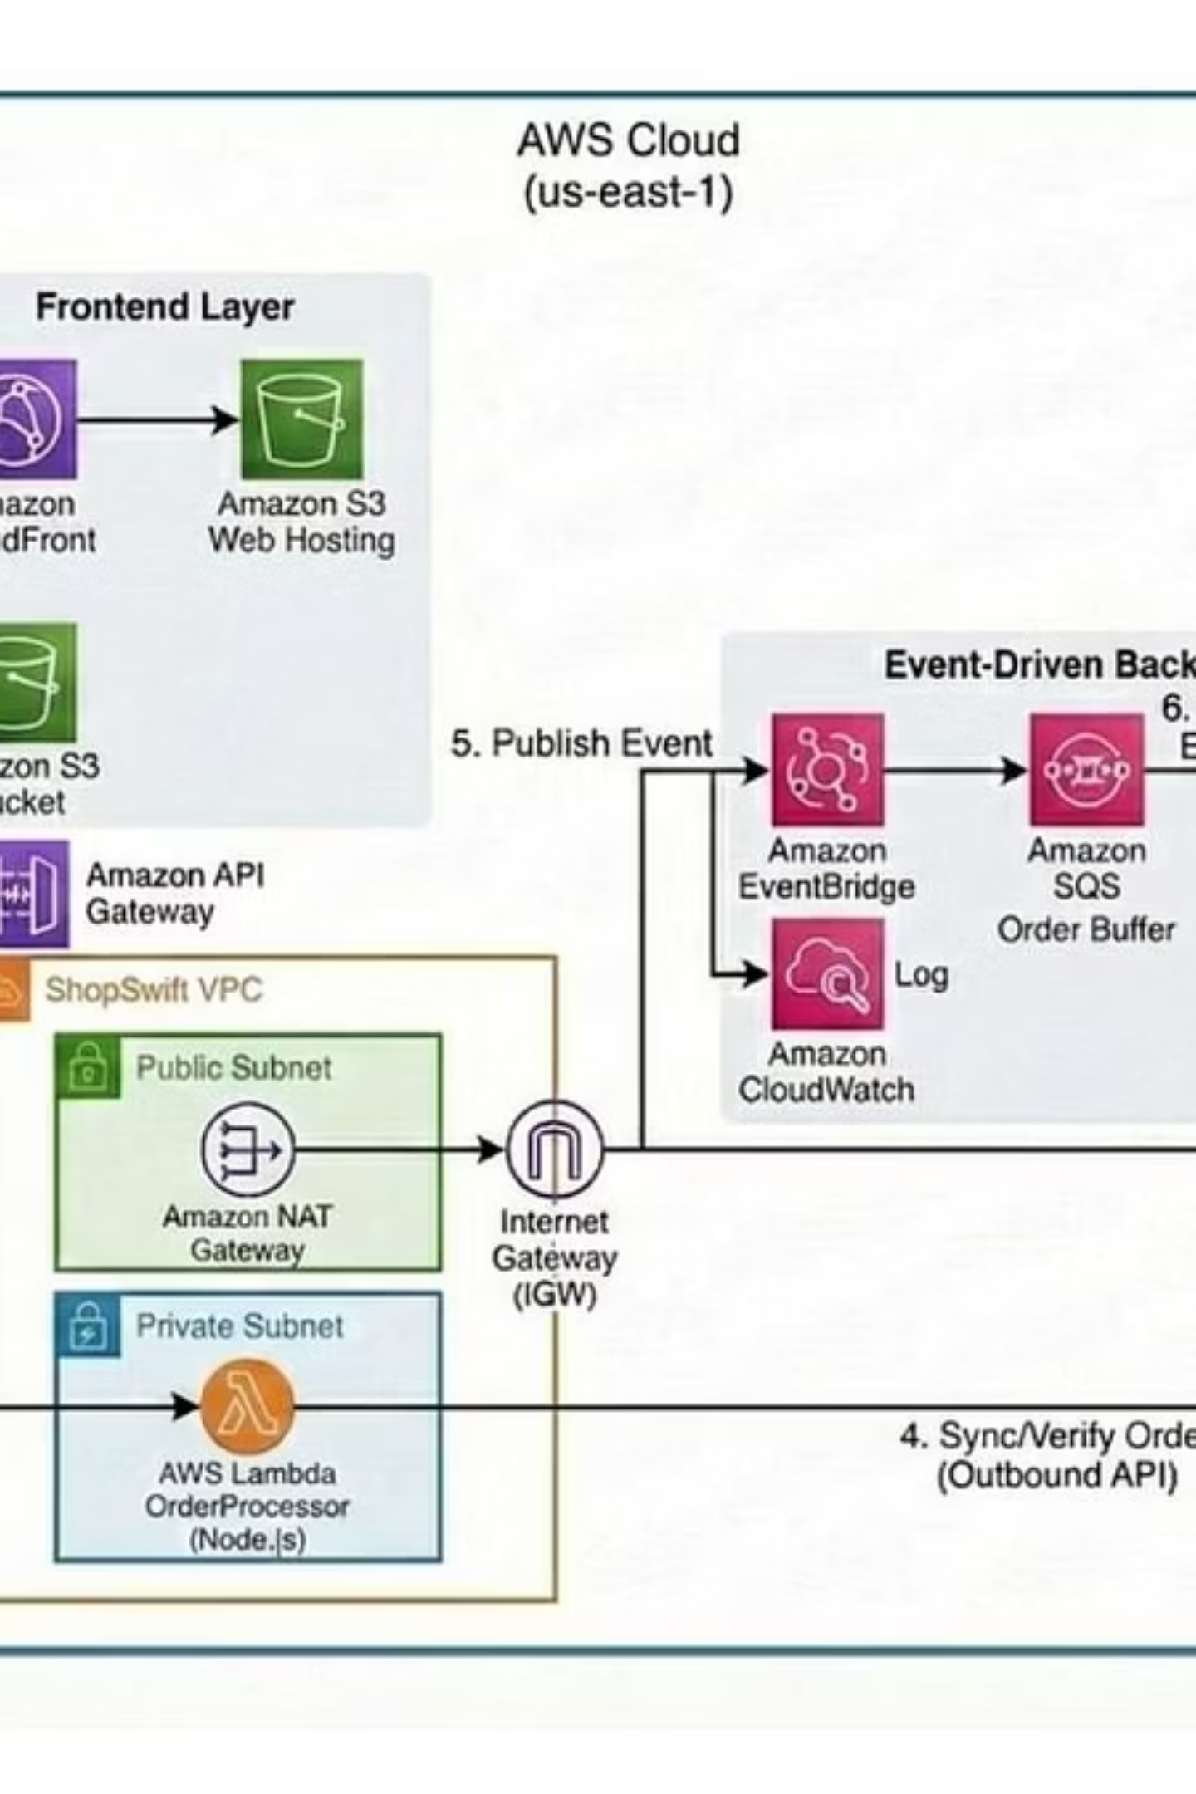
AWS Architecture
Diagram
This diagram illustrates the cloud-based e-commerce system deployed on AWS, showing user interaction, secure order processing, and notification delivery via scalable cloud services.

Slide 10
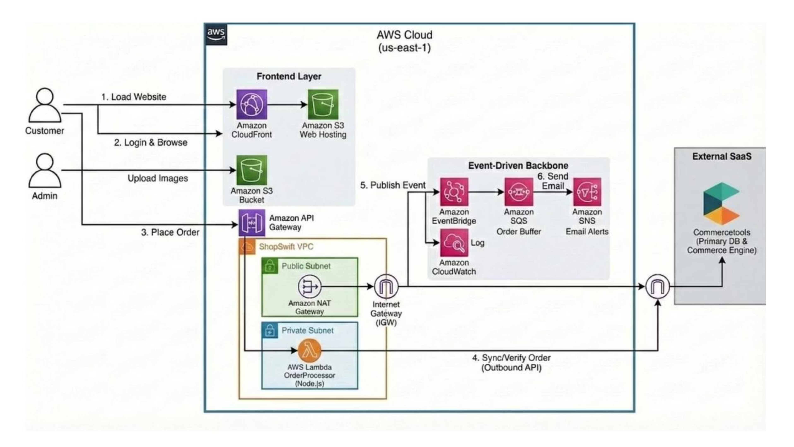

Slide 11
AWS Architecture: Key Components
01
02
Frontend Layer
API Layer
Amazon S3 for static files, CloudFront for CDN, S3 for product images.
API Gateway as entry point, securely forwarding requests.
03
04
Backend Processing
External Commerce System
Secure VPC with NAT Gateway, AWS Lambda for business logic (order validation/sync).
Commercetools for primary commerce engine and database.
05
06
Event-Driven Services
Connectivity
EventBridge, SQS, SNS for reliable processing and notifications, CloudWatch for logging.
Internet Gateway (IGW) and NAT Gateway for secure internet access.

